Slide 1
Mechanical &Thermal properties of lightweight concrete
BY
Sara M. Nasif & Ghufran A. Abdulkareem
supervision by
Dr. Amr M. Ibrahim

Slide 2
INTRODUCTION

Slide 3
CONCRETE 1-cement 2-coarse aggregate 3-sand 4-water

Slide 4
Lightweight concrete
Autoclaved
Aerated concrete
Lightweight aggregate concrete
Foamed concrete
Lightweight concrete that have density less than 1800kg/m^3

Slide 5
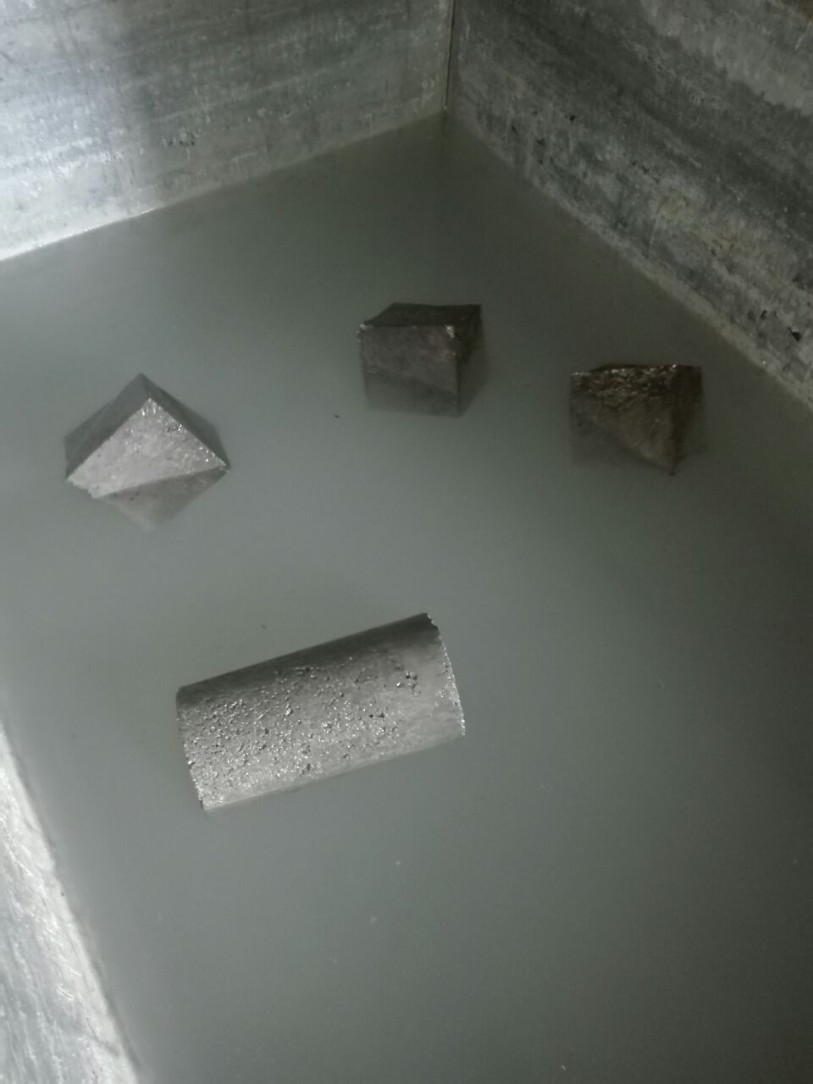
Lightweight aggregate concrete

Slide 6
Lightweight aggregate concrete material
Insulate
Cement
Polystyrene
Water
Taksaboon

Slide 7
the reason of choice polystyrene
1-it have low dead load which lower coast
2- its known as waste material
3-it is a good thermal insulator material
4-it is inner material

Slide 8
the reason of choice polystyrene
1-it have low dead load which lower coast 2- its known as waste material 3-it is a good thermal insulator material 4-it is inner material

Slide 9
the stages of project 1-search period 2-processing models 3-test

Slide 10
Taksaboon mg | Insulate Kg/m^3 | Polystyrene (m^3) | CEMENT (Kg/m^3) | NO. OF MIX
 |  | 1.194 | 420 | 1-
5 | 27 | 1.08 | 380 | 2-
3 | 19 | 1.142 | 390 | 3-
3 | 14 | 1.13 | 380 | 4-
3 | 10 | 1.12 | 400 | 5-
3 | 14 | 1.12 | 461 | 6-

Slide 11
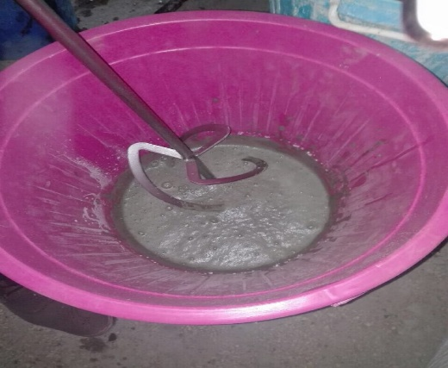

Slide 12
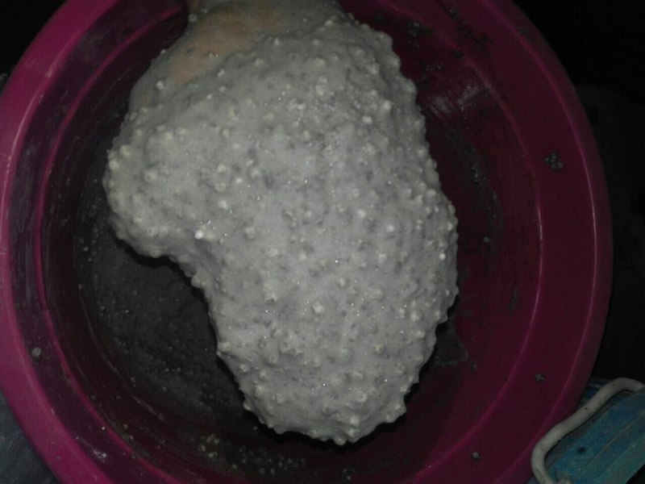

Slide 13
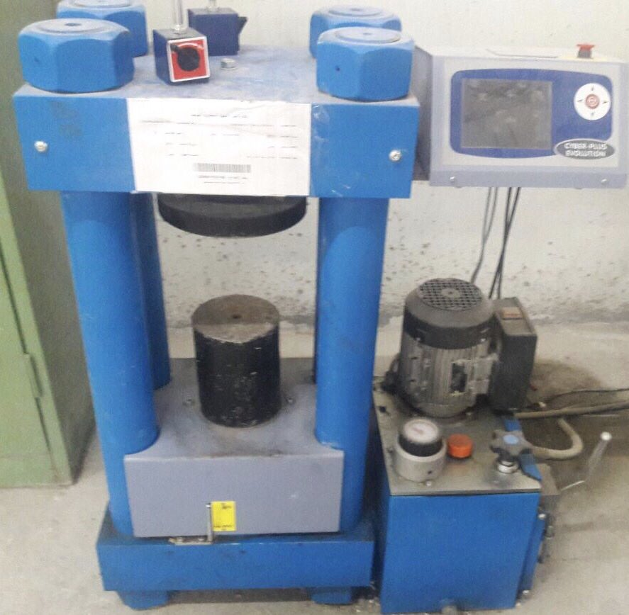
TEST 1

Slide 14
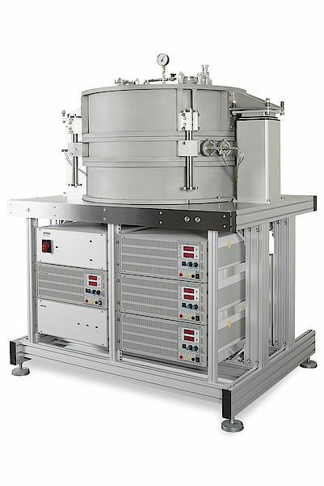
TEST 2

Slide 20
conclusions
Density range (420-1002)kg/m^3
Compressive strength range(0.0145-4.231)MPa
Absorption range (11-18.4)%
Insulate<>compressive strength
Insulate have a good thermal isolator

